Slide 1
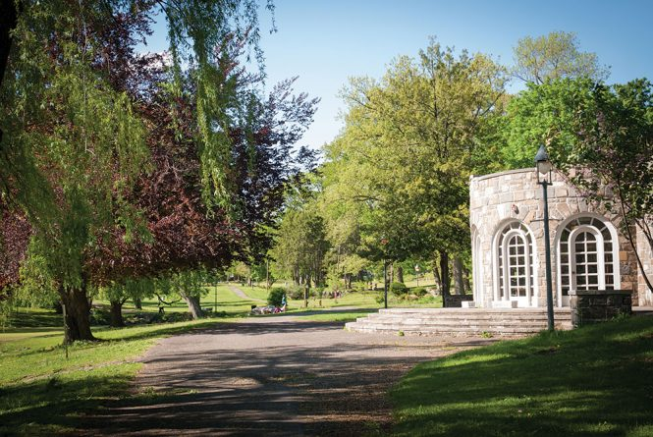
Downing Park Area Under a Curve Using Riemann Sum
Tanya Fraile
Level: Calculus II

Slide 2
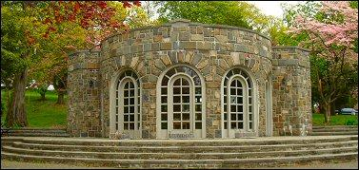
History
35-acre landscape park in the heart of the City of Newburgh
Designed Calvert Vaux (who also designed Central Park
It was named after Andrew Jackson Downing
Officially opened to the public in 1897
Believe the park was a trial run for Central Park
Shelter House wasn’t created until 1934 by Gordon Marvel
Created as a place to change your ice skates and grab a hot coco

Slide 3
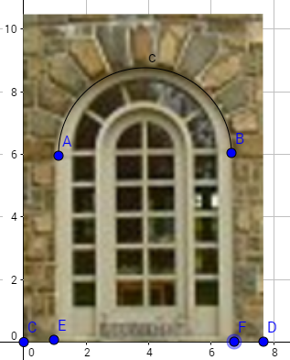
Question
Downing Park’s Shelter House is known for its beautiful arched windows. The Shelter House’s arched window has a base that is 5.75 ft. and a height of 8.75 ft. Using Riemann Sums midpoint, left and right- hand rule find the area under the curve, where $n=5$.

Slide 4
Step-by-Step Solution
1. You must know the equations of Riemann Sums midpoint, left and right- hand rule.
Riemann Sum $R=\sum_{k=1}^{n}{}f(x{}_{k})Δx$
$Δx=\frac{b−a}{n}$
Right End-Point $A =\frac{b−a}{n} [f (x{}_{1}) + f (x{}_{2}) + f (x{}_{3})... f (x{}_{n})]$ Left End- Point $A =\frac{b−a}{n} [f (x{}_{0}) + f (x{}_{1}) + f (x{}_{2})... f (x{}_{n−1})]$
Midpoint $A =\frac{b−a}{n} [f (x{}_{1/2}) + f (x{}_{3/2}) + f (x{}_{5/2})... f (x{}_{n−1/2})]$

Slide 5
Step 2
. By knowing that the length of the window is 5.75 ft. long (which is our $a−b$) and that $n=5$, we must first divide $n$ by the length to find the width of our rectangles.
$$Δx=\frac{5.75}{5}=1.15 ft$$

Slide 6
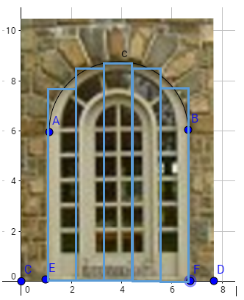
Step 3a
Now that we know the length of our rectangles ($Δx$) we can begin to find out the area under the curve using Riemann Sums midpoint.
Graph your rectangles

Slide 7
Step 3b
Plug in the appropriate numbers into the equation:
$A =\frac{b−a}{n} [f (x{}_{1/2}) + f (x{}_{3/2}) + f (x{}_{5/2})... f (x{}_{n−1/2})]$
$a= 1.15 (7.75 + 8.5 + 8.75+ 8.5 +7.75)$ $a=1.15 (41.25)$ $a≈47.44 ft$

Slide 8
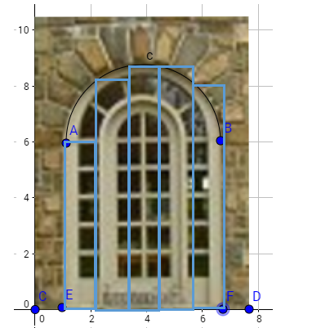
Step 4a
Using Riemann Sums Left hand rule find the area:
Draw the appropriate rectangles:

Slide 9
Step 4b
Using the appropriate equation plug in the number:
$A =\frac{b−a}{n} [f (x{}_{0}) + f (x{}_{1}) + f (x{}_{2})… f (x{}_{n−1})]$ $$a= 1.15 (6 +8.2+8.7+8.7+8.2)$$ $a= 1.15 (39.8)$ $a≈45.77 ft$

Slide 10
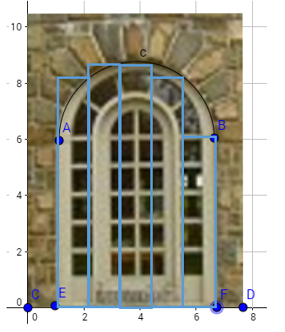
Step 5a
Using Riemann Sums right hand rule find the area:
Draw the appropriate rectangles:

Slide 11
Step 5b
Using the appropriate equation plug in the number:
$A =\frac{b−a}{n} [f (x{}_{1}) + f (x{}_{2}) + f (x{}_{3})... f (x{}_{n})]$
$a= 1.15 (8.2+ 8.7+ 8.7+ 8.2+6)$ $a= 1.15 (39.8)$ $a≈45.77 ft$

Slide 12
Step 6
Now that we have an estimation of the area from three point we will now add them up and divide by three to find the average area:
$a=\left(45.77+ 45.77+ 47.44\right)÷3$ $a=(138.98)÷3$ $a≈ 46.33 ft$

Slide 13
Answer
Therefore, the area under the curve of the Shelter House is approximately 46.33 ft. (Answer may range closely to 46.33 based on estimated values for $f(x)$)

